Slide 1
Social Media Analytics & Chatbots
RX 319
Introduction to Healthcare Analytics

Slide 2
Learning Objectives
Describe how to analyze social media data.
Describe how a chatbot learns to answer questions.
2

Slide 3
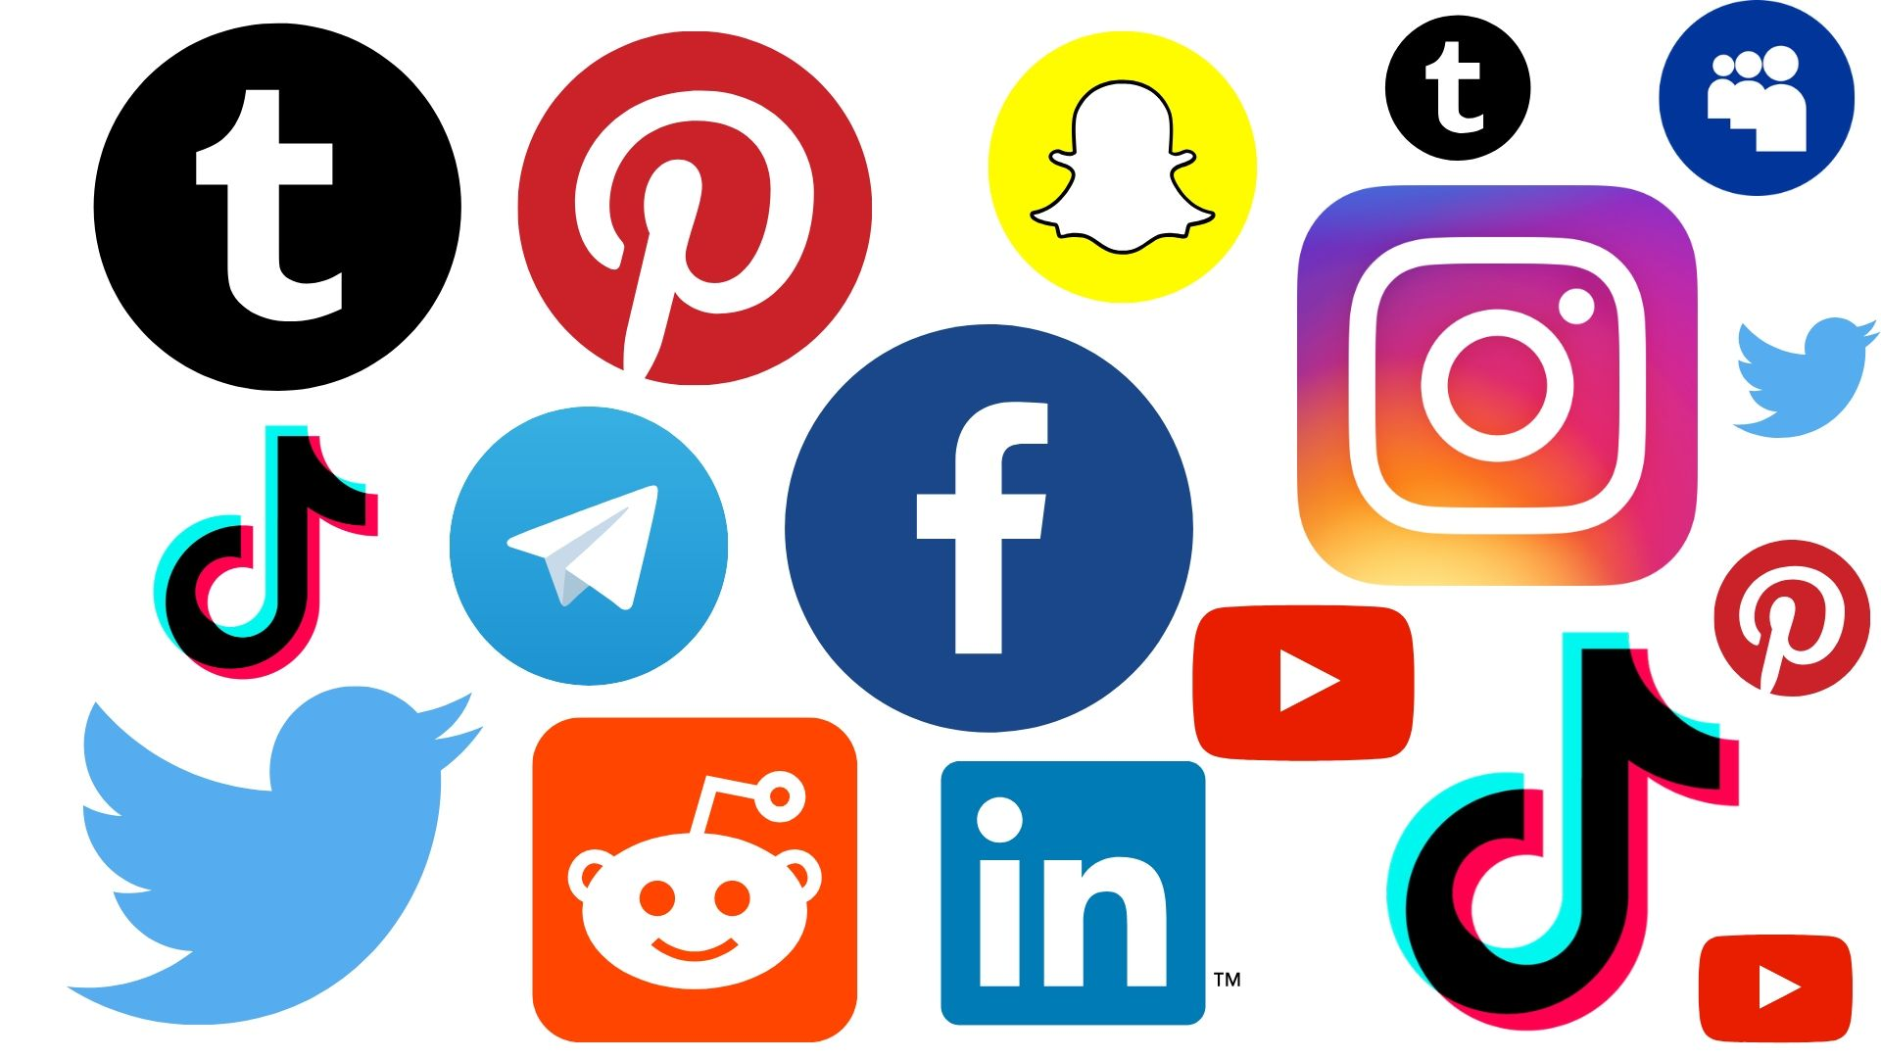
Social Media Analytics
Social media data can be downloaded and analyzed to see how your organization is doing
Identify changes and improvement
These data sets are big, we need help from AI
3

Slide 4
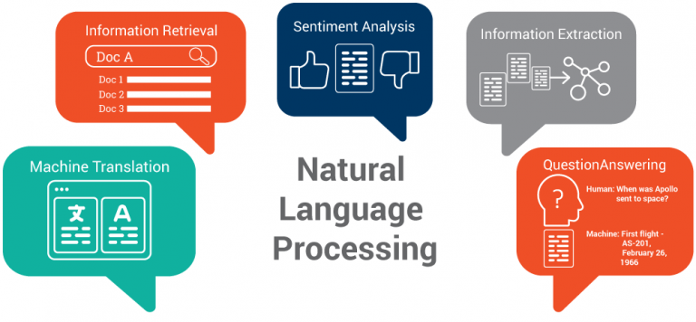
Analyzing Social Media Data
Natural Language Processing (NLP)
Teaching computers to understand text like people can
Identify sentiment of social media posts, even if a review score isn’t provided
4

Slide 5


Analyzing Social Media Data
Comment | Score
Service was friendly and helpful. | 4
Food was good and made correctly. Also got a coupon for a free taco. | 5
The guy running the drive through managed to put EVERYTHING IN THE BAG UPSIDE DOWN | 1
The last time I was there the Diet Mountain Dew fountain was still broke after weeks of not working | 1
This place is garbage!! | 1
Comment
The chicken cheesy Gordita Crunch is the best thing you’ve ever made.
Got kicked out of an empty Taco Bell
I guess I’ll NEVER eat at @tacobell again since they wanna take my money and not give me any food
I’m at a combination Taco Bell and Long John Silvers AND I’M LOVING EVERY SINGLE SECOND
They got a new slushee at Taco Bell so good
5

Slide 6
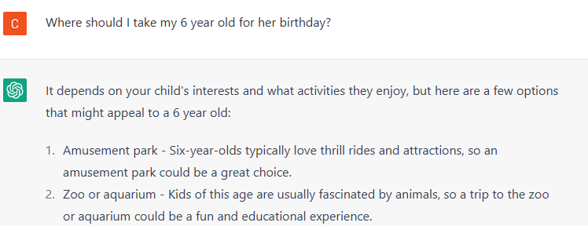
What about Chatbots?
AI-based chatbots start with a limited set of “knowledge”, connecting possible questions with their answers.
Chatbot accepts feedback from users
Was my answer correct/helpful?
Feedback goes into NLP model, and helps the computer make better Question/Answer connections.
Session with ChatGPT. 13 Feb 2023
6

Slide 7
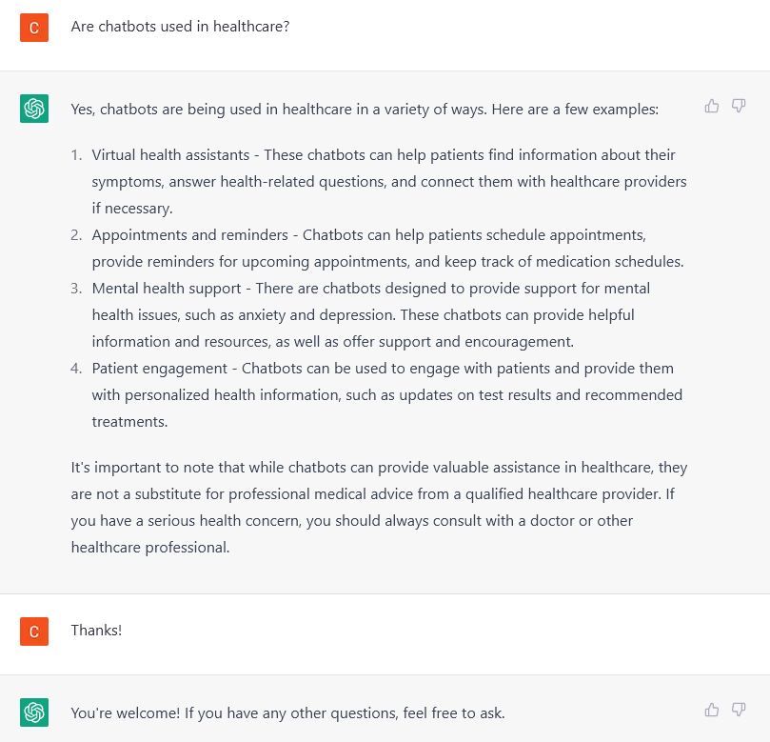
Chatbots in Healthcare
Virtual health assistants
Appointments and reminders
Mental health support
Patient engagement
Not a substitute for professional medical advice
7
Session with ChatGPT. 13 Feb 2023

Slide 8
Summary
Natural Language Processing helps computers connect words to meaning.
Social Media data can be analyzed to improve operations.
Chatbots can quickly connect patients and customers with certain information.

